Slide 1
Professional Development for Federal Buildings Personnel Program Brief – April 28, 2015

Slide 2
Requirements of the Act

Slide 3
Who is involved in implementing?

Slide 4
Who is Impacted (by FRPP)?

Slide 5
Why? It Saves Money

Slide 6
The FBPTA Core Competencies

Slide 7
Better Buildings Workforce Guidelines

Slide 8
GSA - 2014 Assessment

Slide 9
Property Manager Development Tracks

Slide 10
Building Retuning at NCR: 7-20% Savings

Slide 13
Addressing barriers to implementation

Slide 15
FEDSAT Assessment on SF Tool

Slide 18
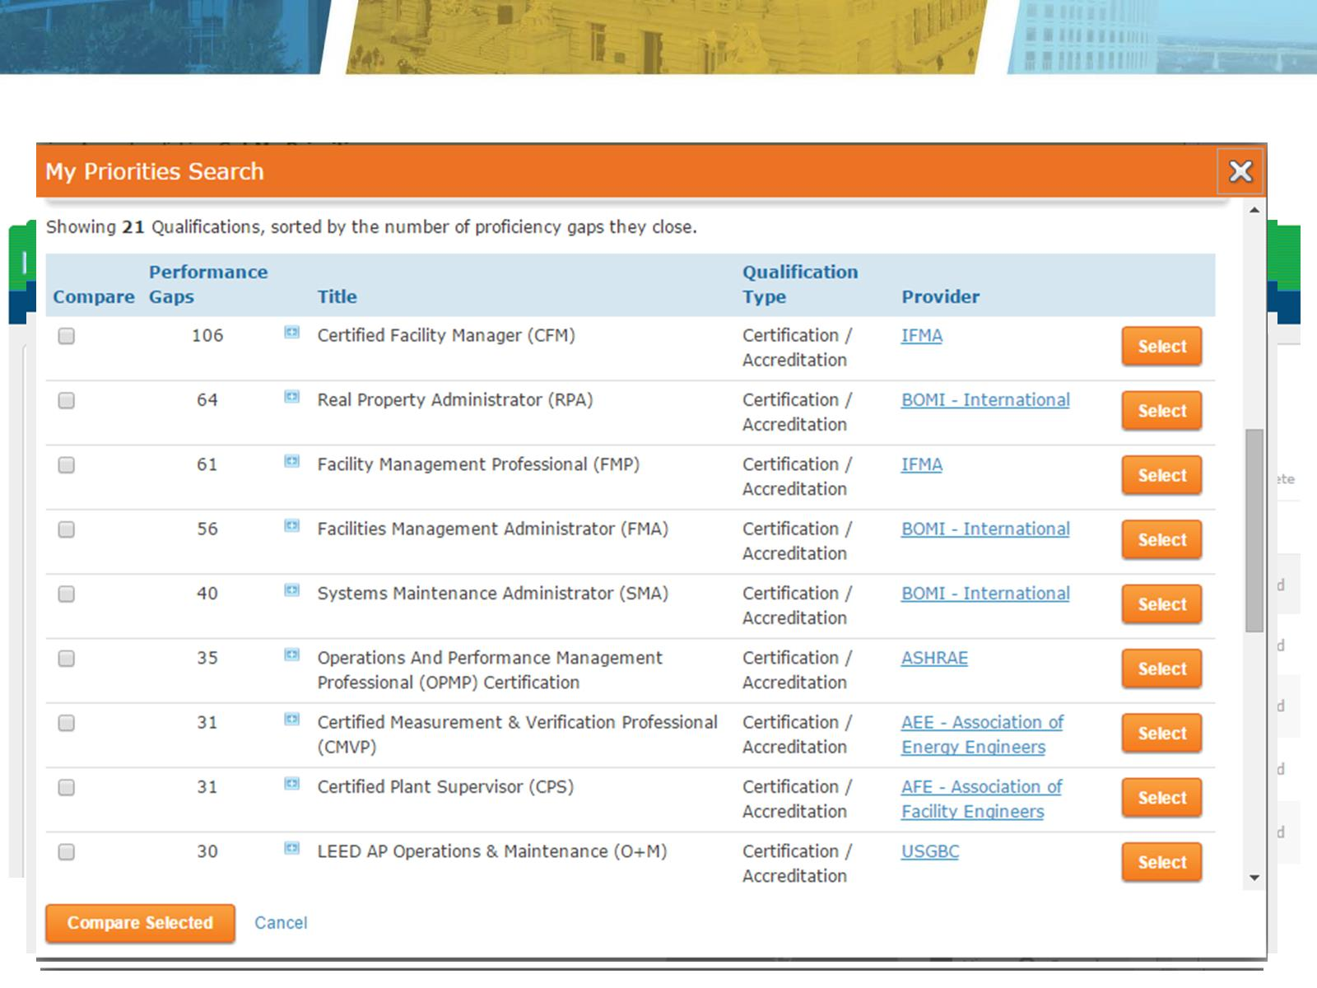

Slide 20
Conclusion

